Slide 1
HR Cultural Transformation

Slide 2
Overview
An interactive session focused on defining the cultural traits, desired behaviors and strategies for HR transformation within and across DC Government agencies.
An overview of the HR Effectiveness initiatives will be shared and participants will be engaged in shaping the HR cultural model for sustainable high performance and effectiveness of HR services.
Our objective is to gain a consensus on the priorities for the HR cultural traits, identify plans to operationalize the traits and competencies district-wide and support branding efforts for a sustainable high performing HR community.

Slide 3
Agenda
Timing | Key Topic | Facilitator
00:00 – 00.15 | Introduction & overview of transformation The DCHR Transformation journey Key milestones Implementation plans with key strategic initiatives Projects 2013 -2014 (recruiting service delivery, training and development) | Kimberly Williams & Aon Hewitt
00:15 – 00.60 00:15 – 00.30 00:30 – 00.60 | Defining DCHR’s transformed culture Background Where we started the journey and key gaps in desired culture Cultural traits of high performing organizations Recommended cultural traits for DCHR Making it real for DCHR Definitions cultural traits for DCHR Ranking and rating the cultural traits Your feedback around the cultural traits and their definitions Discussion around the core elements of the prioritized cultural traits | Aon Hewitt
00:60 – 00.90 00:60 – 00.85 00:85 – 00.90 | How do we operationalize these cultural traits? What do we change? What are the marked changes in behaviors that we want to demonstrate for each cultural trait? How would you practice these changes? How will you hold each other accountable? Next steps Finalized traits and behaviors Branding | Aon Hewitt

Slide 4
DCHR
Transformation

Slide 5
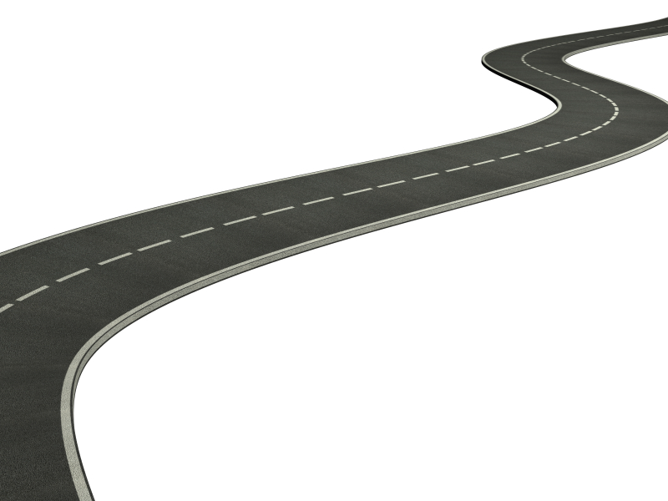
2012: Our journey
Our Journey…
Finalize Culture Traits
September-October 2013
DCHR
Brand
Continue HR Culture
Transformation WorK
September 2013
WE ARE HERE!!
December 2013
Customer Care Strategy Launch
November-December 2012
Job Specification Re-engineering
(Class & Comp) February 2013
Finalized Assessment and Recommendations
November 2012
Launch HRE Workstreams
(L&D, Recruit & Staff)
April 2013
Began Next Phase Action Planning
January-February 2013
Began Next Phase Action Planning
January-February 2013
Culture Assessment Work (Interviews, Surveys, etc.)
September-October 2012
Began HR Culture Transformation Work
September 2012
Director Stokes Appointment April 2011

Slide 6
What Have We Done?
What Have We Done?
Three HR Effectiveness Work Streams were identified from the comprehensive analysis
Learning and Development
Recruitment and Staffing
Customer Care and Cultural Transformation
Activated Work Streams 1 and 2 in April 2013
Classification and Compensation Reform committee continued its efforts as planned with Labor Management Team.
Cultural Transformation work will launch by September 2013 through partnership with the consulting firm and LMPC.
DCHR Customer Care Strategy first pilot was launched in November 2012 and second pilot in July 2013.

Slide 7
How Did We Get Here?
Why the HR Effectiveness Initiatives?
Obtain clear understanding and oversight for training and the development opportunities for employees across the District.
2012 DC Department of Human Resources (DCHR) engaged a consulting firm to conduct a comprehensive analysis of HR Services, Culture and Training.
Survey results validated key areas for improvement.
Classification and Compensation Reform had already begun. Work originated in 2002 as part of Labor Management and DC Government Administration agreement.
DCHR had already launched the Customer Care Strategy efforts at the end of FY2012
DCHR had already begun the SWOT analysis with HR community to gain insight on HR services, processes and systems.

Slide 8
What Does this Mean?
Job Specifications
Career Management
Learning & Development
Career Paths ensure that employees have skills necessary to perform at job specification levels.
Learning & Development courses will be linked to specific Career Paths and Career Progression Plans at all levels.
Core Competencies
Performance
Management
Core Competencies will be defined by and linked to the Performance Management system.
Learning & Development courses will focus on Core Competency development.
Cultural Traits

Slide 9
Where Are We?
Defined Framework for the following:
Standard Job Specifications
Career Progression Program
Learning and Development Strategy and Governance Model
Framework that links learning to Career Management Paths and Career Progression
Delivery of Recruitment and Staffing Services

Slide 10
Learning and Development
Vision
Empower District employees through cutting edge learning and development opportunities that support career development and growth which results in a high performing government.
Improving lives through learning!
Strategy
Provide oversight for learning and development for District government employees
Ensure career management is integrated into learning and development
Establish a structured base level assessment and evaluation process to ensure quality and effective learning and development
Create synergy between learning and development programs and an employee’s career path
Utilize a blended learning model to enhance and increase delivery options

Slide 11
Recruitment and Staffing
Vision
To have every Talent Acquisition be a memorable “Red Carpet” experience for all of our customers.
Strategy
Design and implement a reliable and consistent service delivery model for all employment changes
Ensure processes are clearly defined and aligned to the acquisition and management of talent
Drive organizational strategy with effective partnerships, tools, and systems
Establish standard service level agreements
Provide clear centralized HR governance and oversight for talent acquisition and management
Position the District Government as an employer of choice

Slide 12
What’s Next?
Ongoing Communication of HR Effectiveness Strategy
Finalize and implement the transition plans
Classification and Reform - FY2014
Learning and Development Strategy and System (ELM) – 1Q FY2014
Recruitment and Staffing Framework and System (ATS) – FY2014
Policies impacting the service delivery model
Secure an Applicant Tracking System (ATS)
Implement services on the ATS
Commence the HR Cultural Transformation initiative – Sept

Slide 13
DCHR
Culture

Slide 14
Defining Culture

Slide 15
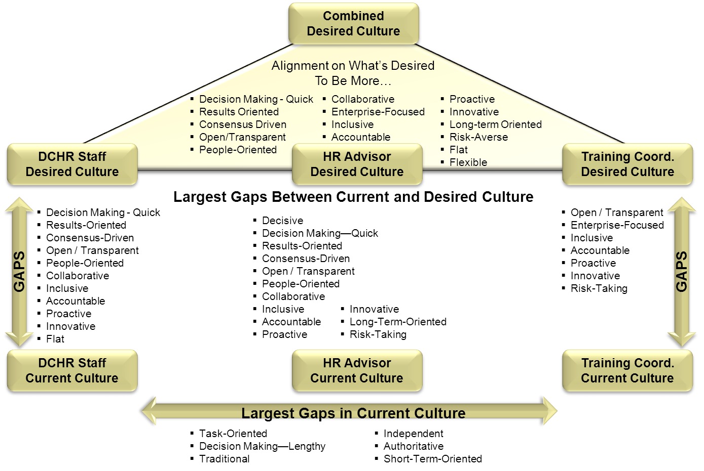
What were the Culture Gaps?

Slide 16
High Performing Culture Profiles
High-Performing Culture Profiles by Strategy
Rank order of difference from average company profile | All High-Performing Companies | Primary Strategy within High-Performing Companies
 |  | Innovation | Customer Service | Quality | Cost Leadership
1 | Decisive | Decisive | Decisive | Proactive | Enterprise-focused
2 | Long-term oriented | Risk-taking | Open/ Transparent | Long-term oriented | Long-term oriented
3 | Proactive | Long-term oriented | Long-term oriented | People oriented | Collaborative
4 | Open/ Transparent | Proactive | Proactive | Open/Transparent | Results-oriented
5 | People oriented | Growth-focused | Action-oriented | Decisive | Decisive
Bold text indicates unique difference from overall high-performing culture profile.
!
Top Culture Traits of Low-Performing Companies:
Short-term oriented
Indecisive
Reactive
Secretive/Closed
Task-oriented
While these culture/operating environment descriptors are valuable, it is necessary to identify and align the cultural drivers that will have the most impact on creating and sustaining the high-performing culture that supports business objectives.
Source: Aon Hewitt’s Consulting Engagement 2.0 Study

Slide 17
How Do We Transform?
Sustainable cultural change would involve touching all dimensions of the culture namely:
Decisions (How we make decisions)
Interactions (How we interact with each other)
Strategy & Business Model (What assumptions should we have about our strategy and business model)
As we prioritize key culture traits to focus on, we would want to touch on all key elements of culture.

Slide 18
Recommended Traits for DCHR
Culture Trait | Base Definition | Dimension | Extent of Change
Proactive | Acting with foresight serving to prepare for, intervene in, or control an expected occurrence or situation | Strategy & BM | 2.5
Accountable | Work is completed with individual ownership and responsibility for process and outcomes | Interactions | 2.1
Decision Making – Quick | Decisions are made and implemented in a short amount of time with limited bureaucracy or approvals | Decisions | 2.0
Open / Transparent | Expressing thoughts and feelings in a direct, candid and honest way; willing to listen to or accept different ideas or opinions | Interactions | 1.8
Collaborative | Most work is done or preferred to be done in teams with common objectives | Interactions | 1.6
Results oriented | Focused on goal attainment; practical, concentrating on achieving a purpose | Decisions | 1.5
Flexible | Work is done with general guidelines that allow adaptability and adjustments to met changes or constraints | Strategy & BM | 1.1
Externally focused | Focus and attention placed on managing the organization's external environment, customers, competitive forces, markets, political, regulatory and economic environment | Strategy & BM | 0.5

Slide 19
Making The Desired Culture Real (Part 1)

Slide 20
Prioritization Activity
Time | Task | Instructions
XX minutes | Culture Trait Identification | Based on the Culture Survey findings and the recommended culture traits for DCHR, identify the top three traits important to bringing Mayor Gray’s ONE CITY initiative to life Reflect on why you consider each identified trait important by writing these down on a pad One-by-one, explain your top three traits from the list and provide your explanation as to why you think this is an important trait Discuss as a group any traits identified that require further clarification
XX minutes | Culture Trait Prioritization | Based on the group discussion, identify the top three traits that would be most important for DCHR to support the ONE CITY initiative Mark your top three traits on the recommended trait list using the dots provided Based on the dots and general consensus, determine what the top 3 traits are as a group List these three traits identified on the chart found on the following worksheet
XX minutes | Culture Trait Analysis | With each top trait identified, discuss the key topics below: Definition: How would you define the trait? What are some key identifiers (behaviors, actions, etc.) to the trait? Risk/Gaps: What are the possible barriers that would make the traits hard to manifest in DCHR? Note any key takeaways identified

Slide 21
Prioritization Chart
Key Trait
Analysis
Definition | Risks/Gaps
How would you define the trait? What are some key identifiers (behaviors, actions, etc.) to the trait? | What are the possible barriers that would make the traits hard to manifest in DCHR?
Focus Areas
(Here)
(Here)
(Here)

Slide 22
Making The Desired Culture Real (Part 2)

Slide 23
Operationalizing Activity
Time | Task | Instructions
XX minutes | Defining Behaviors | Based on each final trait prioritized and aligned to by the group, discuss the key topics below: Current State: Does the trait manifest itself in DCHR today? Why or why not? Future State: How should the trait manifest itself in DCHR? What identifiers (behaviors, actions, etc.) would prove that the trait is manifesting? [PROVIDE AT LEAST 3 IDENTIFIERS PER TRAIT] List your answers on the cart found on the following worksheet
XX minutes | Defining Accountability | As a group, discuss how we can hold each of the key stakeholder groups accountable for manifesting the prioritized trait: HR Advisors Agency Leaders DCHR Staff DCHR Leadership List potential action items, solutions, activities, etc. that each key stakeholder group can do.
XX minutes | Defining Action Plan and Success | Based on the group discussion, identify the TOP key action item, solution, activity, etc. for each stakeholder group List each identified action item, solution, activity for each stakeholder group on the chart found on the following worksheet Define how your group can ensure/support each stakeholder group’s success in accomplishing the action item, solution, activity, etc. Define a reasonable timeline as to when the action item, solution, activity, etc. can be completed.

Slide 24
Defining Behaviors
Key Trait
Defining the Trait Behaviors
Current State | Future State
Does the trait manifest itself in DCHR today? Why or why not? | How should the trait manifest itself in DCHR? What identifiers would prove that the trait is manifesting?
Focus Areas
(Here)
(Here)
(Here)

Slide 25
Defining Actions and Success
Culture Transformation Driven Through Accountability
HR Advisors
Agency Leaders
DCHR Staff
DCHR Leadership
DCHR LEADERSHIP
Key Activity
How we will ensure success?
When it should be completed?
HR ADVISORS
Key Activity
How we will ensure success?
When it should be completed?
DCHR STAFF
Key Activity
How we will ensure success?
When it should be completed?
AGENCY LEADERS
Key Activity
How we will ensure success?
When it should be completed?

Slide 26
Next Steps

